Slide 1
Why do most Data Science projects fail?
Where does it all go wrong?​
Fawad A. Qureshi Industry Field CTO November 2022

Slide 2
Do you recognize any of these numbers?
85%
90%
80%
50%
95%
Failed Data Science projects
Number of useless Data Lakes
Time spent in data prep
Data exact repeat of >5 other projects
Unable to deliver new insights in 6 months

Slide 3
Key blockers to Data Science projects success
01
Shiny new toy syndrome
Selecting tools without doing the basics or understanding business value
Lack of Integration / Data Silos
02
Lack of a single consolidated environment. Data spread across multiple tools and technologies.
03
Lack of Talent / Understanding
Not having the right talent in teams and trying to fix it in the wrong fashion.
Lack of Operationalization
04
Projects never leaving the labs.

Slide 4
Shiny New Toy Syndrome

Slide 6
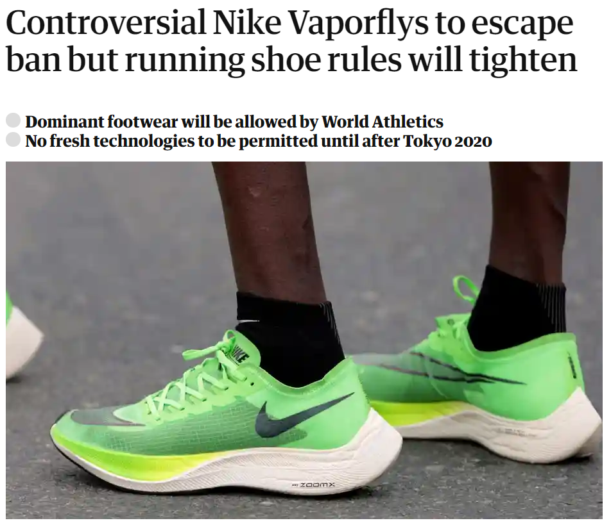
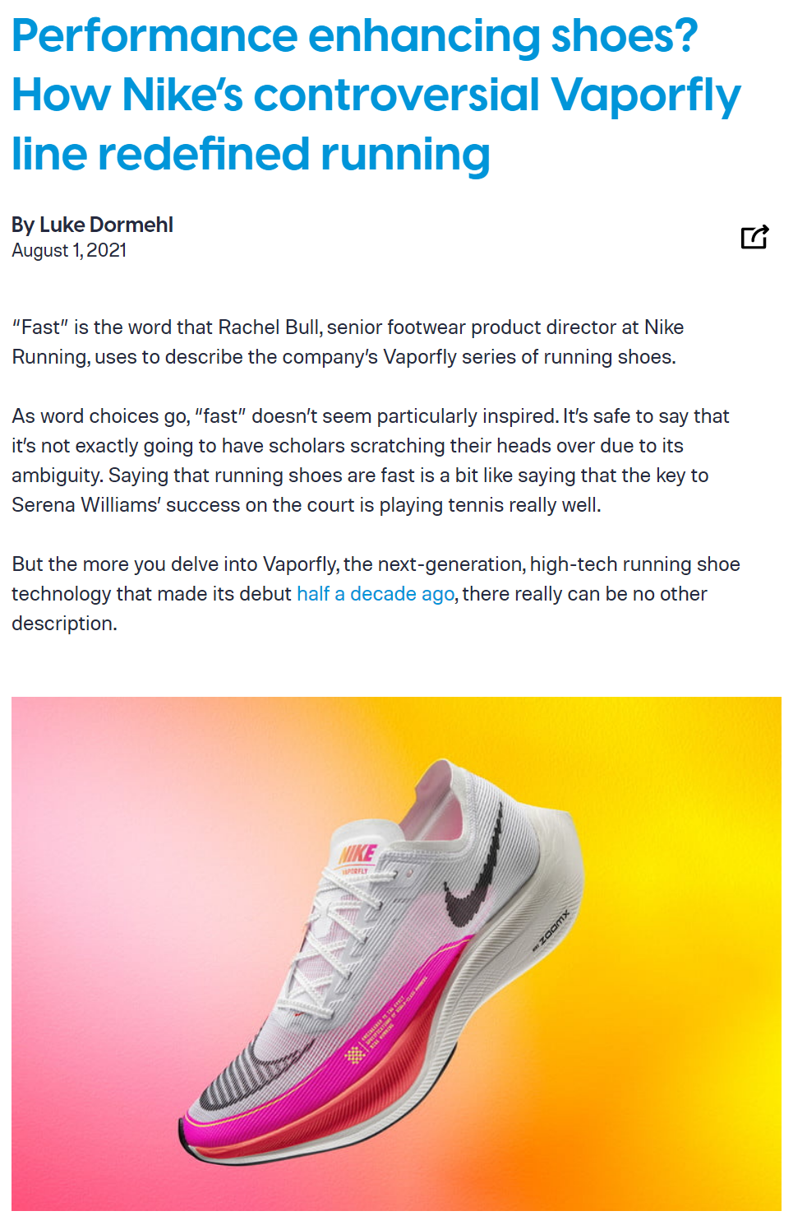
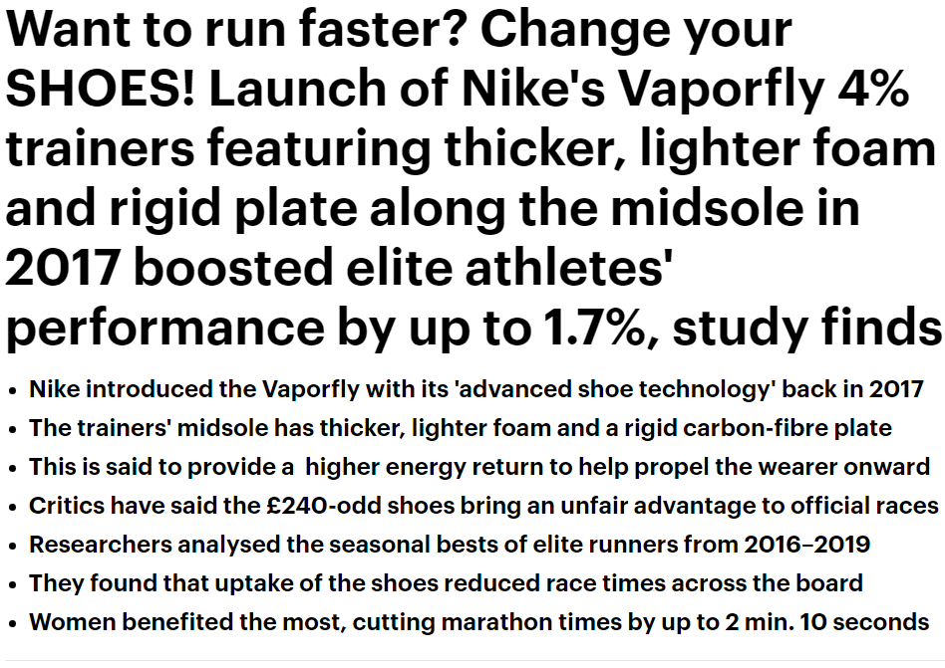
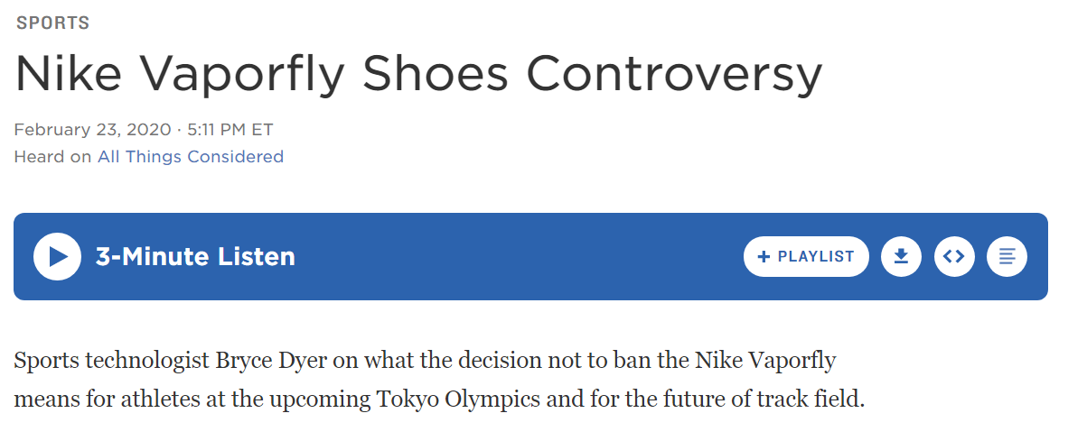
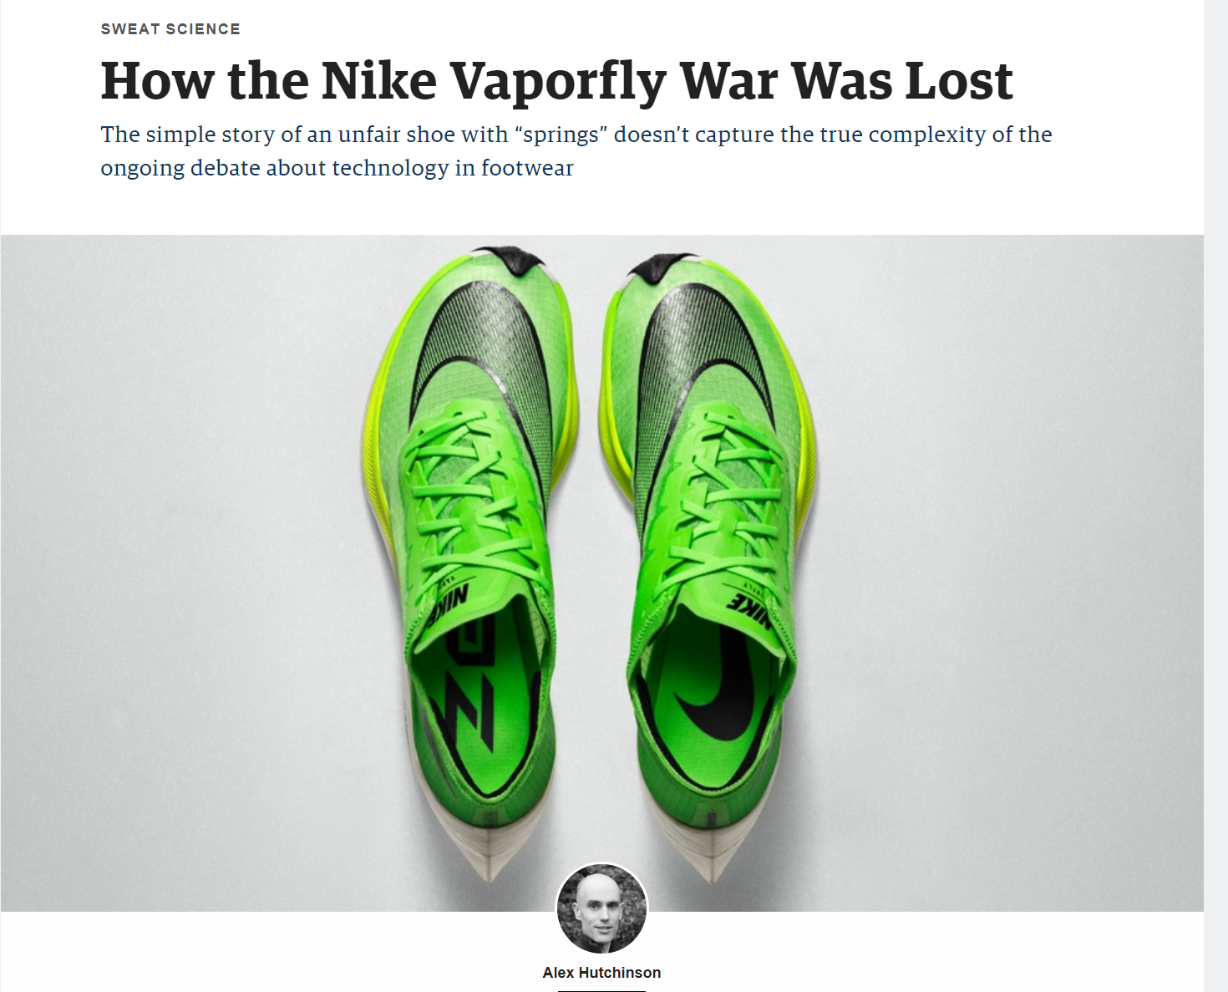

Slide 7
Old Business Process
+
Expensive New Technology
=
Expensive Old Business Process

Slide 8
Lack of Data Integration

Slide 9
Data Silos in Utility Industry Prevent Value Realization
Financial
Supply
Chain
Third-Party
87%
Enterprise
Applications
SCADA
Log Data
IoT
of firms are expanding their ability to source external data¹
Projects
Process
Control
Transactional
Data
¹ “The Insights Professional's Guide To External Data Sourcing” Forrester, 2020
Notes:
Companies are falling short of realizing the potential of data because of the proliferation of data silos.
With the rise of the application cloud (Salesforce, Workday) and infrastructure clouds (AWS, Azure, Google Cloud), the amount of data we have to drive our businesses has exploded, but that data is now spread across different silos and environments.
These silos aren’t just within an organizations four walls. It includes sourcing and incorporating third party data (something 87% of firms want to do more of (Forrester)), silos between suppliers, or even how you get data to customers. Additionally, silos continue to get added. Mergers and acquisitions are on the rise, introducing new silo complexity to bring data and different clouds together
All these silos are expensive and time-consuming to extract value from, and governance and collaboration are nearly impossible across multiple technologies and clouds.

Slide 10
Unified Data Warehouse is a foundation for Artificial Intelligence.
Andrew Ng
Leading AI Researcher

Slide 11
Realizing Data as an Asset in Utilities
ENRICH, EXTEND, ENHANCE, ENGAGE
PRODUCTIONISE
COLLABORATE
PRODUCTISE
MONETISE
DATA
INTEGRATION
DATA
RE-USE
DATA
SHARING
DATA CLEAN ROOMS
DATA SCIENCE / APPLICATIONS
World class Utilities data model & data management makes advanced analytics much more productive
Re-use of integrated data produces more efficiencies
& better ROI
Collaborating with data & analytics = context &
competitive advantage
Data clean rooms &
productization are
business fundamentals
Multi-cloud commercialization strategies take advantage of native application development

Slide 12
Lack of Talent

Slide 13
How do we fix the talent gap?
“Citizen Data Scientist” is defined as a person who creates or generates models that uses advanced diagnostic analytics or predictive and prescriptive capabilities, but whose primary job function is outside the field of statistics and analytics.

Slide 14
Lack of Operationalization

Slide 15
Operationalizing Analytics
Hidden Technical Debt in Machine Learning System
Configuration
Serving Infrastructure
Monitoring
Data Collection
Data Verification
Machine Resource Management
ML
Code
Analysis Tools
Process Management Tools
Feature Extraction
Source: https://papers.nips.cc/paper/5656-hidden-technical-debt-in-machine-learning-systems.pdf
Notes:
Operationalizing analytics
This illustration taken from a Google paper that you may be familiar with entitled “the hidden technical debt in Machine Learning Systems”.
Paper make the point that the glamorous bit that we all like to talk about – training ML models – is really just the tip of a giant iceberg.
Since 80% of the time and effort required to train a model is typically spent acquiring and preparing data, it’s critical to be able to re-use data wherever possible. That means a structured approach to acquiring and cataloguing data and to creating “feature stores” of variables that can be re-used across multiple models.
Key issue is operationalization. That means being able to repeatedly and rapidly score models, so that model output can be embedded in operational processes. It also means being able to track, monitor and manage model performance – because as we said earlier, predictive models have a half-life.

Slide 16
Process of Data Science
Evaluate
Deploy
Train
Feature
Engineering &
Transformation
Visualize &
Understand
Collect Data
Business Outcomes
Success depends on getting the right data at the right time to the correct models.
Notes:
data scientists begin by finding, collecting, understanding, and preparing the data (steps 1-3). They may use business intelligence tools to better understand the data and formulate a hypothesis. Data scientists experiment with many data sets throughout this iterative process. Whenever they broaden or extend the scope of the data set, they have to wait for data engineers to load and prepare the data. This causes a delay and introduces significant latency between iterations. They also must “shape” the data into a normalized form, and many algorithms require nuanced formats. Next they run training data through the models prepared in earlier steps (4), evaluating the outcomes to determine each model's effectiveness, then further tune the models through cycles of feature engineering (3) and hyper parameter tuning (4). The resulting trained models are then deployed to production (5) to empower business users with predictive and prescriptive tools. Once deployed into production, the models receive ongoing evaluation (6) to identify model-drift and determine whether the models are out of date. Models must be periodically retrained with fresh training data. These model updates represent yet another iteration of the ML cycle, and require processing more data which is time consuming and prone to errors. Depending on the use case, the models may need to be retrained as frequently as every few hours, days, or weeks.

Slide 17
Why Snowflake?
How does Snowflake address these problems?

Slide 18
Snowflake Overview
Enabling secure data sharing and monetization at scale.
FAST FOR ANY WORKLOAD
IT JUST WORKS
CONNECTED TO WHAT MATTERS
Run any number or type of jobs across all users and data volumes quickly and reliably.
Replace manual with automated to operate at scale, optimize costs, and minimize downtime.
Extend access and collaboration across teams, workloads, clouds, and data, seamlessly and securely.
Notes:
To meet the needs of your business, a platform has to have the following key requirements:
It needs to be fast for any workload. Performance is non-negotiable and a platform needs to deliver that speed no matter what the job is, what else is running, or how large the data volumes are.
It needs to just work. Your business cannot rely on a platform that requires manual intervention to not just keep it running but keep it running optimally. You need automations to operate at scale, stay up and running not matter what, and optimize costs so you can do more.
And it needs to connect your business to what matters. Platforms should catalyze access and collaboration across your business - whether it’s connecting analysts to data scientists, regions or different cloud environments, or new data. This needs to be seamless and secured every step of the way

Slide 19
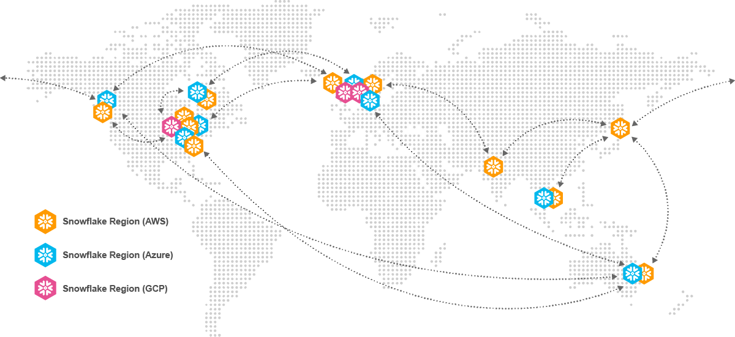
SECURELY SHARE DATA GLOBALLY USING SNOWGRID
AS EFFICIENT AS A UTILITY GRID
1
Cross-Cloud & Cross-Region
Live, Ready-to-Query, No ETL
On-Demand Provisioning
Data, Logic & Services
Personalized Data and Metadata
Multi-language UDF/External Functions
Secure
Multi Party Governance
Revocable Access
2
3
Snowflake Regions
AWS
Azure
GCP
Notes:
Snowflake is fundamentally different. Under the hood of the Snowflake platform, is Snowgrid. A unique technology that spans globally, connecting regions and clouds together, and enables secure and governed data sharing.
Three pillars set Snowgrid apart:
First, Snowgrid allows you to share live, ready-to-query data cross-cloud and cross-region without any ETL. With on demand provisioning, data is available across cloud and region when you need it.
Second, Snowgrid allows you to share personalized data and metadata, as well as business logic to ensure your ecosystem has the data and tools they need to collaborate.
And third, Snowgrid provides increased governance and security controls. With multi-party governance controls - like row-level access policies and data masking, you are able to know and control your data in a centralized and flexible way. Additionally, data access is fully revocable. While other technologies allow you to stop sharing data, they don’t allow you to fully revoke access. With Secure Data Sharing, you are able to completely remove access to the data, enabling you to better comply with industry regulations like the Right to Erasure.

Slide 20
Snowflake Platform for DS & ML
Scalable development and operations with pushdown using your tool of choice
Snowsight
Azure
Machine
Learning
Data & Feature Eng.
Training
Inference
Monitoring
Consumption
Snowpark
DataFrames | SProcs | UDFs & UDTFs
Ext. Functions
Custom Logic + Snowsight
Streamlit in Snowflake²
Hybrid Tables²
Elastic Processing Engine
Warehouses | Snowpark-optimized Warehouses¹
SQL
Python
Java
Anaconda Repository of OS Libraries
Cloud Object Store
On-Prem²
Apache Iceberg²
External Storage Extensibility
External Tables
Data Enrichment
Snowflake Data Lake
Data Ingestion
structured | semi-structured | unstructured
Data Sharing | Marketplace
Files
Streaming
Snowpipe | Snowpipe Streaming²
Advanced Governance
RBAC | Tag-based Masking | Anonymization | Row & Column Access Policies
¹ Public preview
² Private preview
Notes:
— explain gray box at the bottom
From data storage to data processing, Snowflake’s platform relies on a robust foundation of governance to ensure data is protected across every step of the machine learning workflow in a way that is consistent for all data types and all processing languages used in the platform. This enables organizations to broaden and democratize access to data without compromising compliance or security requirements.
— explain data access foundation
As seen in the challenges slide, machine learning is impossible to scale without a robust data foundation.
Whether data is available in Snowflake or kept in a cloud object store such as S3, or Google Cloud Storage, Snowflake supports unlimited access to all data. Snowflake makes it easy to bring together batch and streaming data as well as provide access to structured, unstructured and everything in between such as JSON and other semi-structured data formats. And even if it exists outside of the organization’s account through secure data sharing and the Snowflake Marketplace. And of course, for those that have already established external data lakes, Snowflake can provide access to your cloud or on-prem store through external tables.
— explain processing layer
Once all the relevant data sets are identified, Snowflake’s Data Cloud offers a powerful processing engine – decoupled but deeply integrated with your data – to quickly and reliably process a near-unlimited volume of data with your language of choice.
With Snowpark, the development experience extends beyond SQL and adds support for popular languages in data science such as Python which comes with integrated access to the Anaconda repository and package manager to make open-source innovation easily accessible yet governed to protect your data.
Regardless of the language used, Snowflake’s intelligent infrastructure handles scaling and performance tuning, so data scientists can spend more of their time building models. This includes the ability to do large scale, single-node training using Snowpark-optimized warehouses which are great for all your memory-intensive operations including training and many feature pipeline and inference scenarios. External functions come as a way to feed data to externally hosted models where you may already be running online or low-latency predictions.
We are moving with you towards a world of more complex and large scale real-time or online inference which is where Hybrid Tables, currently in private preview, come to provide an easy way to serve data at low-latency for your low-latency model inference requirements.
And Snowflake goes a step beyond deploying the model with the option to build apps using nothing more than Python with Streamlit, an integration that is currently in private preview.
Automating all the steps that take raw data into ML insights can be done using Snowflake Streams & Tasks but of course can also be integrated with other transformation and orchestration frameworks such as dbt and Apache Airflow.
— explain development layer
From the start, Snowpark developers have had the flexibility to work from their favorite IDE including Jupyter Notebooks or VS Code. But of course, there is no need to set up separate tools when using Snowsight, Snowflake’s web interface which now has support for Python development as part of Snowpark worksheets private preview.
Snowflake’s extensibility to do development from your tool of choice, extends beyond IDEs to leading platforms which use Snowflake to both store and process data all while giving you the great user experience available through other platforms such as Hex Notebooks, Dataiku MLOps platforms, or Tecton’s Feature stores and even low-code platforms that extend the value of the Snowflake Data Cloud to many users within your organization.

Slide 21
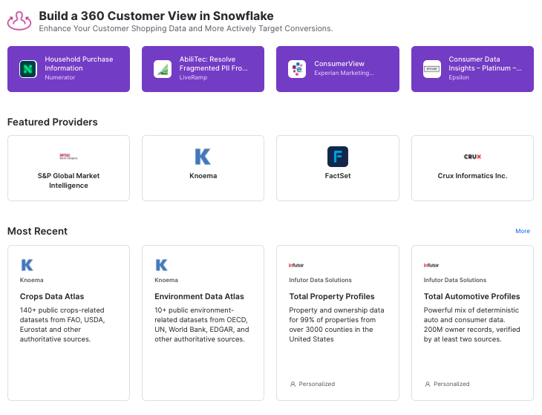
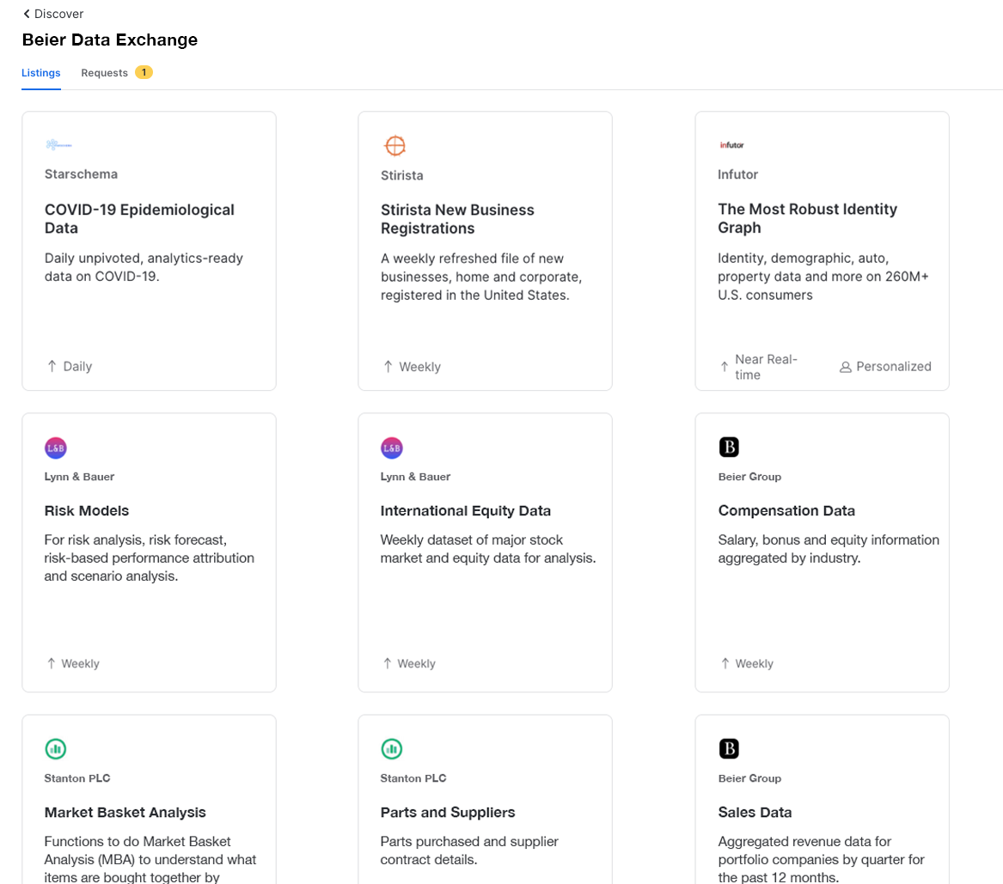
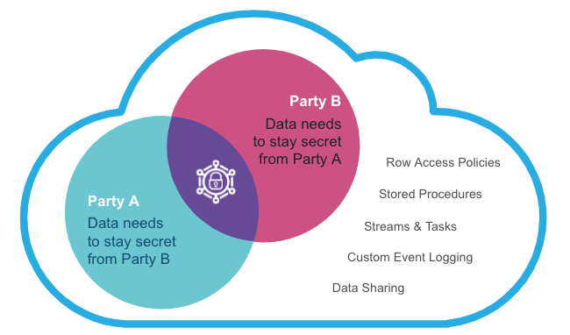
Collaboration in the Snowflake Data Cloud
Privacy-preserving collaboration for every scenario
Discover and Monetize in the Data Cloud
Share Across Your Business Ecosystem
Share with Companies Not Yet on Snowflake
Managed Account
Your Account
Analyze Data without Exposing It
Live, ready-to-query data, services and apps cross-cloud and cross-region. No ETL.
Notes:
Snowflake enables you to deliver privacy-preserving collaboration for every scenario.
You can tap into Snowflake Marketplace to discover third party data, data services or applications from over 200+ providers, or you can market and deliver your own products to the Data Cloud.
Snowflake collaboration also allows you to share across your ecosystem whether that is with other Snowflake accounts or a defined group of accounts. No matter if they are other business units, partners or even your customers.
Not all companies that you may be working with are on the Data Cloud yet, so we also have methods to allow you to securely collaborate with companies who aren’t yet on Snowflake.
One of the most interesting areas that Snowflake supports, is the ability to collaborate on highly sensitive or regulated data. Allowing the analysis of data, without exposing it.

Slide 22
KEY
TAKEAWAYS
01
Start with the business goals.
02
Focus on the core data foundation.
Operationalize analytics through repeatable data pipelines
03

Slide 23
Thank You

