Slide 1
Cloud and Data Analytics Architecture Data Everywhere for Everyone

Slide 2
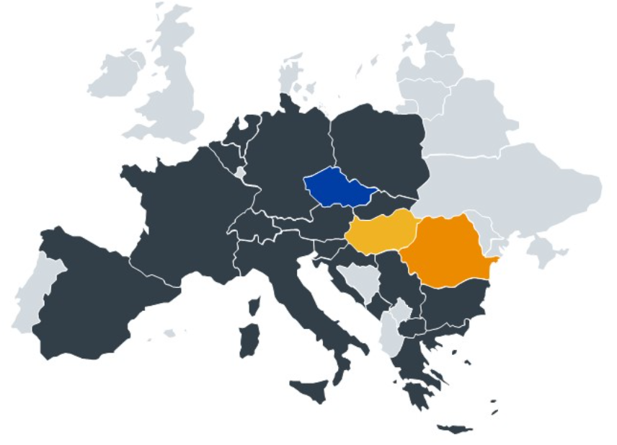
innogy CZ market position: Market leader in natural gas, fastest-growing in electricity and #1 on the CNG market.

Slide 4
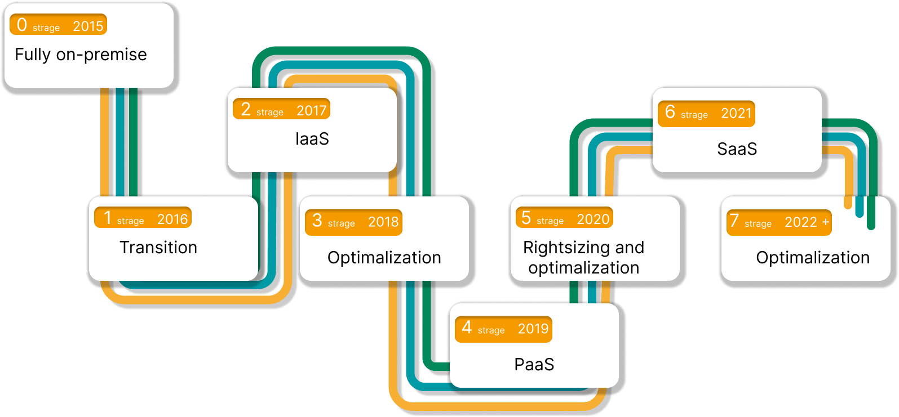
Our cloud story year by year

Slide 5
Cloud will handle all your responsibility on security and data protection

Slide 6
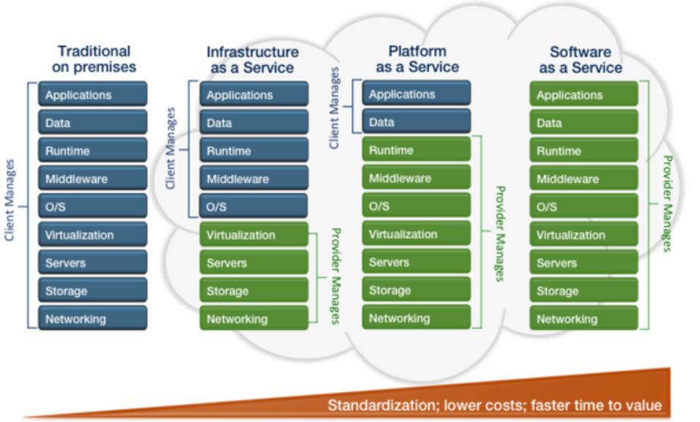

Slide 7
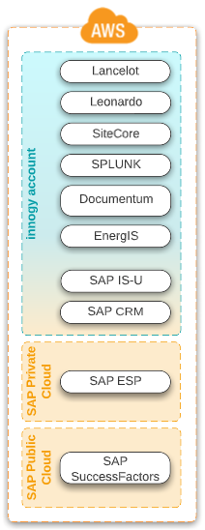
innogy cloud application landscape
AWS OnPremise
Private Cloud (single-tenant):
customer specific development
Public Cloud (multi-tenant):
custom development
Customer AWS account
Vendor AWS account

Slide 8
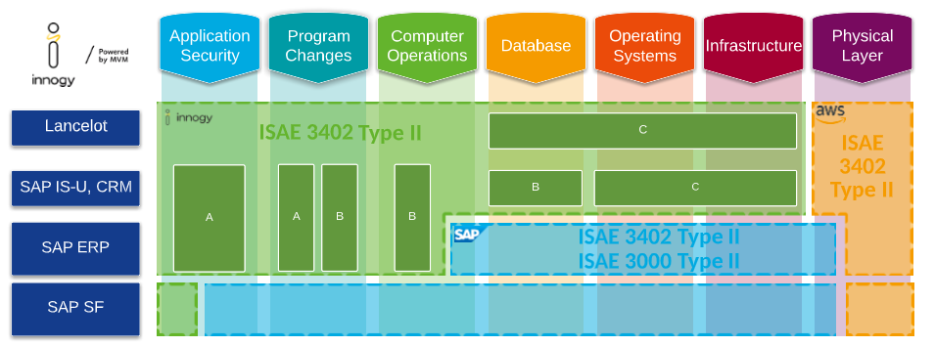
innogy Shared Responsibility Model

Slide 9
Why Doesn’t modern cloud Result in a Modern Data Experience?

Slide 10
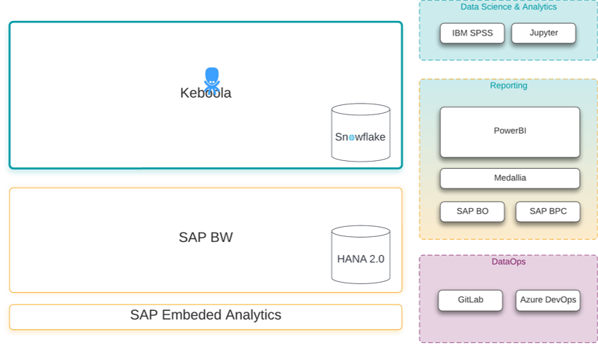
Analytical Database at its Center
ETL data pipelines that extract all the data to database or datawarehouse at its center
Full-blown Data Streaming
A set of microservices commonly configured as a messaging queue
Data Lake at its Center
ELT pipelines that store everything in a data lake, which gets later integrated into an approved data model.
Full-blown Data Mesh
A set of microservices that are not product-oriented like streaming architectures, but are domain-focused on the teams and products

Slide 11
Challenges of the Modern Data Stack?
We integrate so many and focusing more on the integration, administration, and maintenance of those tools instead of building data products.
Who’s going to use the tool?
What data problems is the tool trying to solve?
What are you data governance requirements?

Slide 12
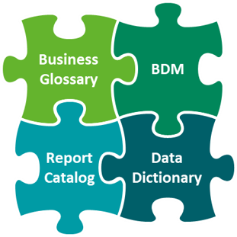
TOOLS

Slide 13
1
Engineering principles testing, code review, CICD
2
SQL well-known language
3
Out-of-the-box testing data integrity, referential constraints, and semantic validity
4
Documentation knowledge repository, data lineage
5
Versioning integrate with git
6
Deployment DataOps practices
Source: 7 reasons why we integrated dbt into Keboola

Slide 14
Data Academy

Slide 15
Modern data architecture

Slide 16
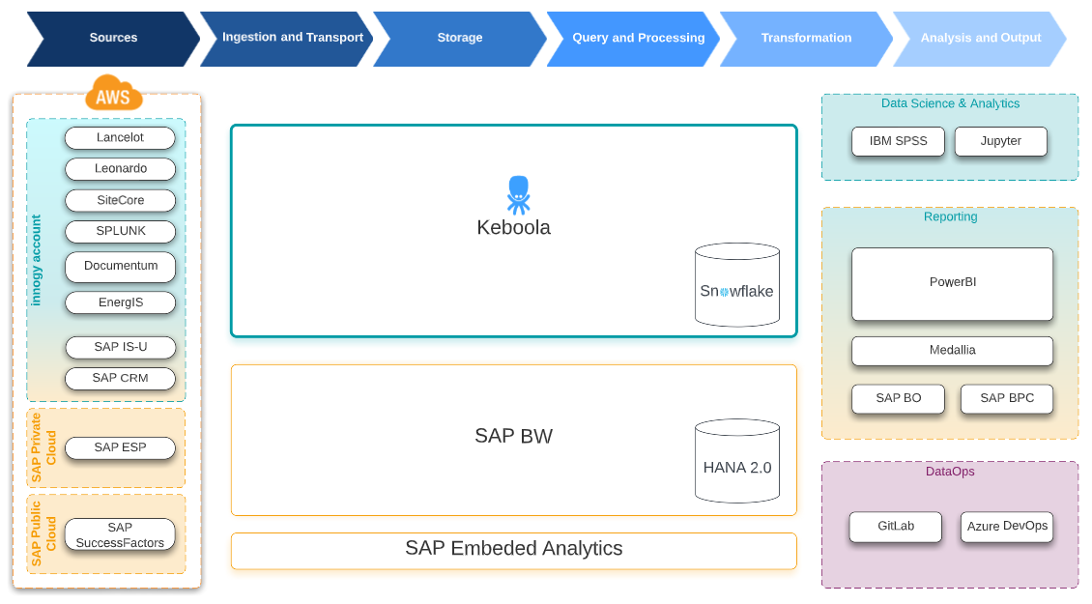
Modern Cloud Data Architecture

Slide 17
Data mesh
As a new approach to sourcing, sharing, accessing, and managing analytical
data at scale

Slide 18
Data Producers
Domain expertise
Data Mesh
Build security controls
Data Consumers
Execute business priorities
Data ownership and governance
Data Quality
Metadata Management
Build and run the platform
Simplify on-boarding
Training and community
Business analytics development
Data Discovery
Data Pipeline development
Creation of new insights

Slide 19
Think Big, start Small and Be Prepared

Slide 20
Thank you!

