Slide 1
Assurance of Digital solutions in Energy
DNV Digital Solutions and DNV Energy Systems
Theo Borst, Head of BD & Consultancy, Performance and Assurance Solutions
November 2022

Slide 2
DNV, an independent assurance and risk management company
157
years
~12,000
employees
100,000
customers
100+
countries
5% R&D
of annual revenue
Ship and offshore classification and advisory
Energy advisory, certification, verification, inspection and monitoring
Management system certification, supply chain and product assurance
Software, platforms and digital asset solutions
Certify, verify and test against standards, specifications and regulatory requirements
Qualify and assure new technologies, systems, data, platforms, supply- and value chains
Give expert advice on safety, technology and commercial risk, and operational performance
Co-create and share new rules, standards, software and recommended practices
Notes:
DNV is a global independent assurance and risk management company. We have close to12,000 employees and operate in more than 100 countries. We pride ourselves on our uncompromising standards of quality and integrity wherever you meet us around the world. We enable our customers and their stakeholders to manage risk and complexity with confidence.
For Maritime customers, we offer classification services and advisory services with the aim of enabling our customers to safely tackle the ongoing decarbonization and digitalization journey.
In the energy market we assure that energy systems work safely and effectively through monitoring, verifying and advising on the energy infrastructure through the full concept, finance, design, build and operating cycles. As such, we have a global bearing on the pace and nature of decarbonization.
We are a leading supplier of Management System Certification and supply chain assurance services across industries with a particular focus on the food, health and automotive sectors.
We offer software, platform, cyber security services and other digital solutions mainly to the maritime, energy and healthcare sectors.
By assurance we mean either overseeing that systems, products, processes or digital assets work safely, effectively and efficiently or providing advice so they may do so.
Through these activities we in DNV enable our customers and their stakeholders to manage risk and complexity with confidence.
Assurance is therefore the fundamental value created as a result of the services we deliver to our customers. These services include:
Certification, verification and testing
The qualification and assurance of new technologies, digital asset solutions, data, platforms, and supply chains; and
Giving expert advice on safety, technology, risk and operational performance, and sustainability.
The co-development and creation of new rules, standards, recommended practices and benchmarks

Slide 3
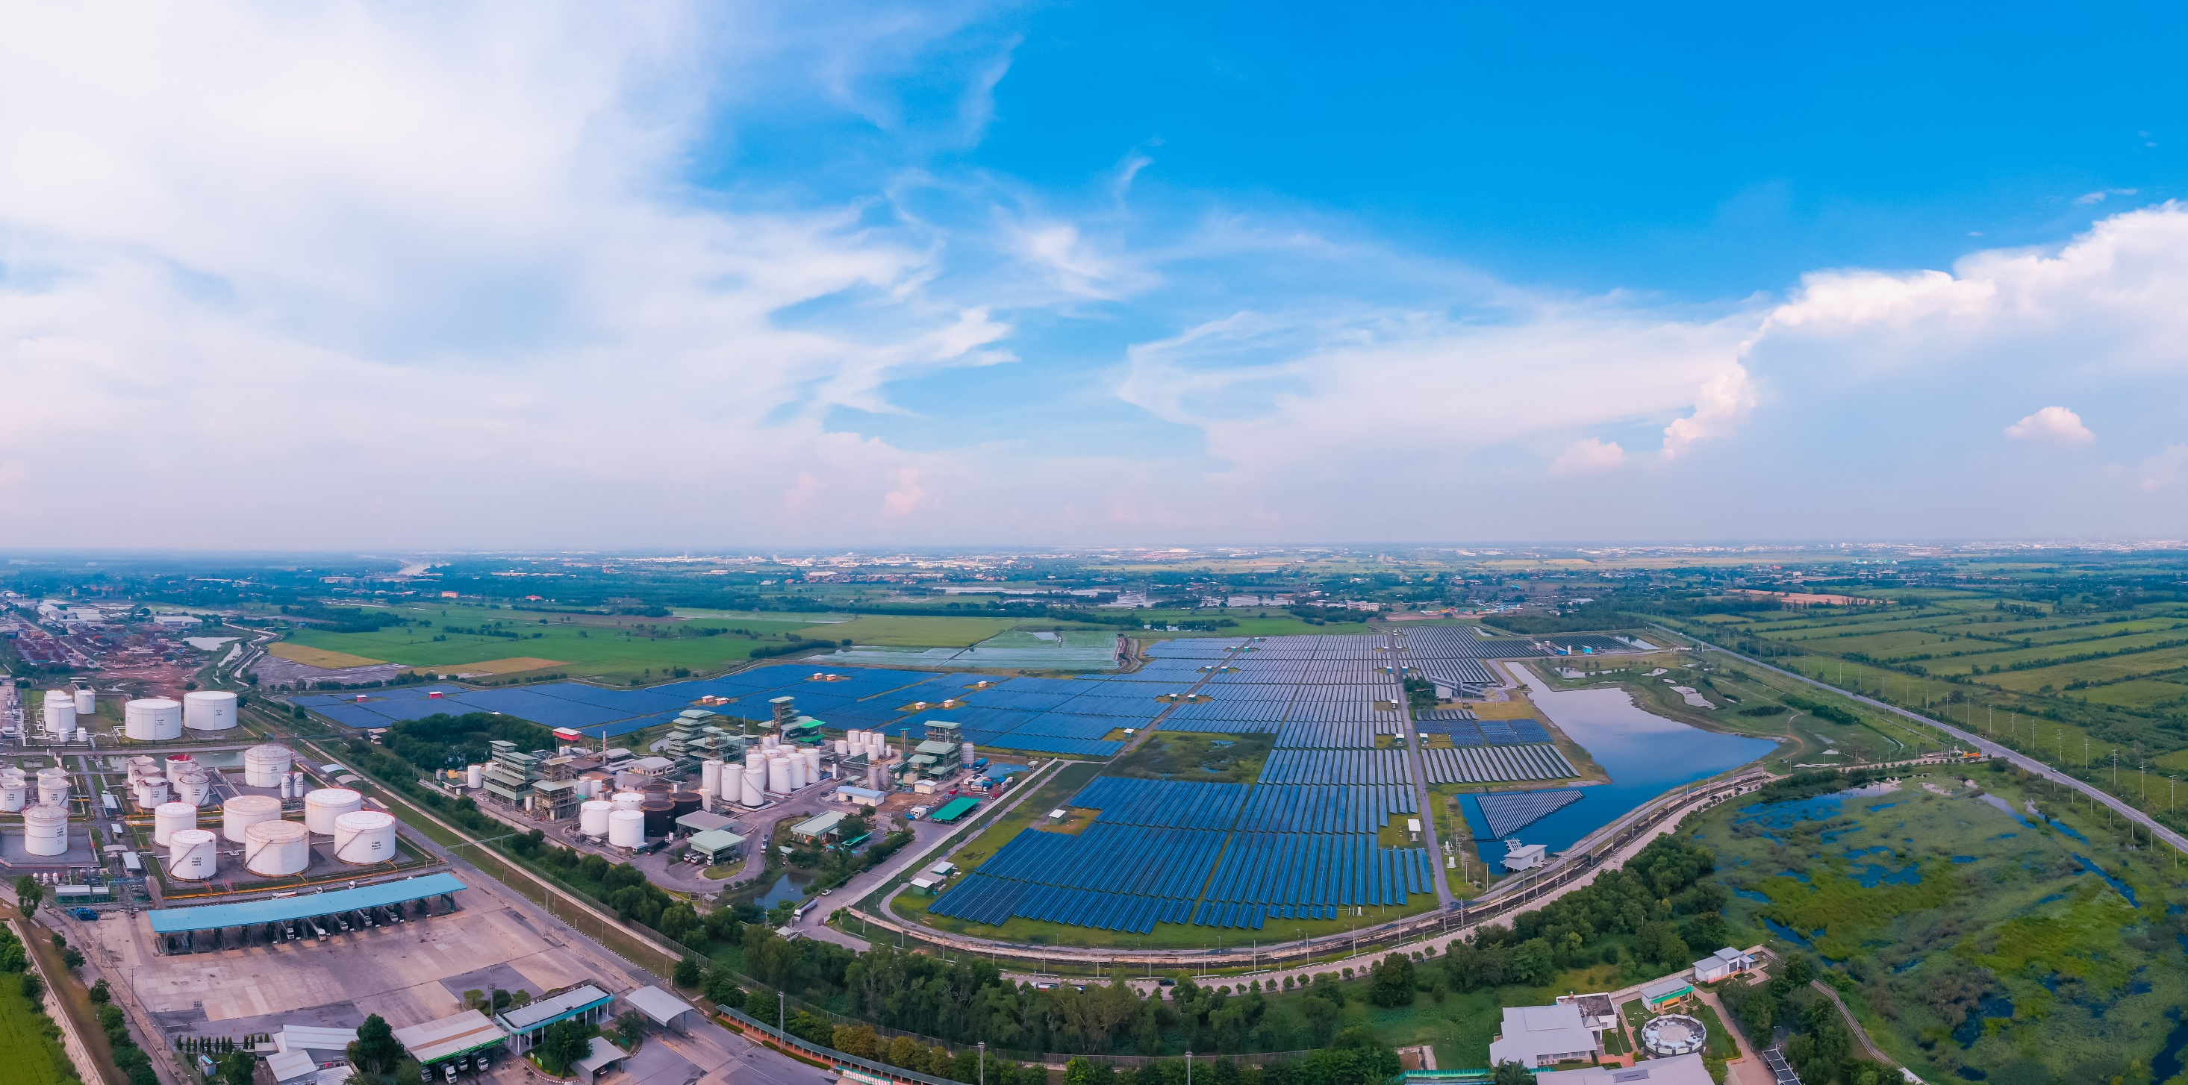
We address challenges in the broader energy industry
Multiple energy transitions across sectors
Deep decarbonization
Integrated energy systems
Secure, affordable energy
Safe, efficient and digital operations
Decarbonization
The world needs to transition faster to a deeply decarbonized energy system in order to meet the Paris Agreement goals
This requires technology and behavioural revolutions, huge innovation and investment, and advances and scaling of technology and infrastructure
Governments and energy industries need to extend renewables to new sectors and work together to scale CCS and hydrogen
This complexity requires understanding and expertise across the energy value chain
Digitalization
Sustainability
Notes:
Much of the energy industry changed significantly in 2020, what with the implications of COVID-19, lower demand and lower prices for fossil-fuels and many governments pushing plans to stimulate their economies via policies and investments designed to decarbonize industries and green their energy systems.
The energy sectors and governments have had, and continue to navigate many complex, interrelated transitions taking place globally and regionally. We foresee a rapid decarbonization of the energy system characterized by widespread electrification and cleaner technologies. But decarbonization of the energy sector that is deep and impactful requires urgent action on a global scale, and while a global energy transition is underway, further action is needed to reduce carbon emissions and mitigate the effects of climate change.
We serve both the oil and gas and the power and renewable sectors in order to assist our customers in accelerating the transition. We see many oil and gas companies transforming into integrated energy companies with an increased focus on sector coupling; i.e., both a broad optimization of energy systems, and a specific focus on energy carriers such as hydrogen.
Safe operations is of course still of paramount importance as oil and gas and power and renewable assets age beyond their operating lives and they look to become more efficient and more digital.

Slide 4
Energy Services
Energy markets and strategy
Risk management
Renewables advisory and monitoring
Renewables certification
Technology advisory and testing
Verification and marine warranty services
Inspection
Grid advisory
Cyber security
Energy management
Qualification and assurance of Digital Asset solutions
.
Notes:
We provide advisory, certification, verification, inspection and digital monitoring services t as well as other services, to the entire energy value chain across generation and production, transmission and distribution, and end use.

Slide 5
Digitalizing and managing business critical activities in a sustainable, cost-efficient, safe and secure way
Software and digital solutions
Wind turbine design
Wind resource and production assessment
Solar PV plant design
Electric grid asset performance
Offshore structural engineering
Processing plant risk and integrity
Pipeline risk and integrity
Fleet management and operations
QHSE and enterprise risk
Performance optimization
Asset design and management
Risk and safety management
Energy transition and sustainable ops
Digital strategy and transformation services
Digital assurance services
Notes:
DNV is a world-leading provider of digital solutions and software applications with focus on the energy, maritime and healthcare markets. Our solutions are used worldwide to manage risk and performance for wind turbines, electric grids, pipelines, processing plants, offshore structures, ships, and more. Supported by our domain knowledge and Veracity assurance platform, we enable companies to digitize and manage business critical activities in a sustainable, cost-efficient, safe and secure way.
BA Digital Solutions provides DNV GL’s key markets worldwide with leading engineering software tools and enterprise solutions, supported by our domain knowledge
We help customers in their digital transformation building on our position as a global software provider and taking full advantage of Veracity
We offer our products and services to the market directly through our sales organization, together with the DNV GL business areas in joint value creations, through selected partners and online from the Veracity platform
Our Veracity platform supports digital assurance services, enables industry networks for secure business collaboration and provides a collaborative ecosystem for digital products
Energy transition and sustainable operations = Sustainability
We will continue to expand and tailor our software portfolio towards renewables and decarbonization of oil and gas. This includes the development of Renewables software as well as new capabilities in the Plant and Structure product lines. Furthermore, this could include joint solutions with BA Maritime and system suppliers for ship operation to optimize fuel consumption and reduce emissions with respect to greenhouse gases
We will support customers to make more sustainable operational choices by use of our analytical applications, risk models and data-based services
PAS unit
Strategic drivers
Contribute to energy transition and decarbonization with focus on energy transmission and distribution
Strengthening DNV’s position as a “digital” assurance company
Enable insight and value from data
Helping our customer in their digital transformation
Secure profitable growth
Key strategic positions
Assurance of digital assets We have over time developed RPs that enables our customers to use their digital assets/digital twins to make business critical decisions and operations.
Conceptualize standards The shared standard for Design Data Model (digital twin) that we develop on behalf of the O&G industry in the READI project, enables DNV to take a leading position within the digitalization of the O&G industry as well as offshore wind and energy production and distribution in general securing interoperability of data (ISO 81346).
Enabling renewable energy into existing distribution lines Through the SGN-RTN project we are among the first that can offer solutions for distribution and optimalizations of various energy sources, enabling renewable energy into existing distribution lines.
Transforming data into
actionable insight, enabling performance and transformation
Veracity
xyz

Slide 6
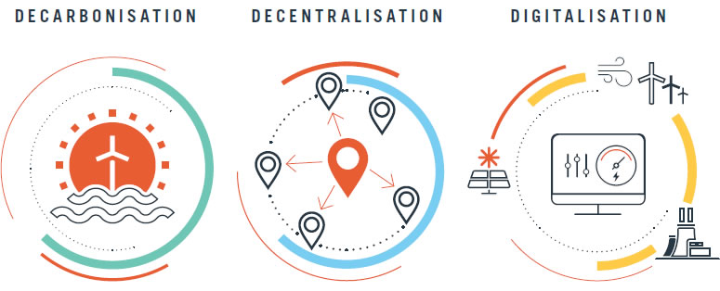
Digital Transformation in Energy
Digital transformation is not (only) about IT. It will change business models for utilities and grid operators, create new revenue streams and provide opportunities to create value.
Smartgrid Mostly about adding digital hardware to the power grid (protection, automation, controllers, meters, sensors).
Digitalization This adds layers of software and applications on top of the smartgrid, using digital technologies like data analytics, AI & ML, Cloud, Mobile and Blockchain. They bring scalability and enables new business models.
This will lead to Improved situational awareness and decision support
Moving from reactive to predictive to autonomous
Forecasting (weather, congestion, prices, outages)
Predictive analytics (asset management)
Becoming more data-driven and digitalized
Automated verifications and assurance of digital asset solutions
The MAIN question to digital transformation and implementation of Digital Asset solutions: How will Digital Transformation solve a Business need and how are Business value drivers affected?

Slide 7
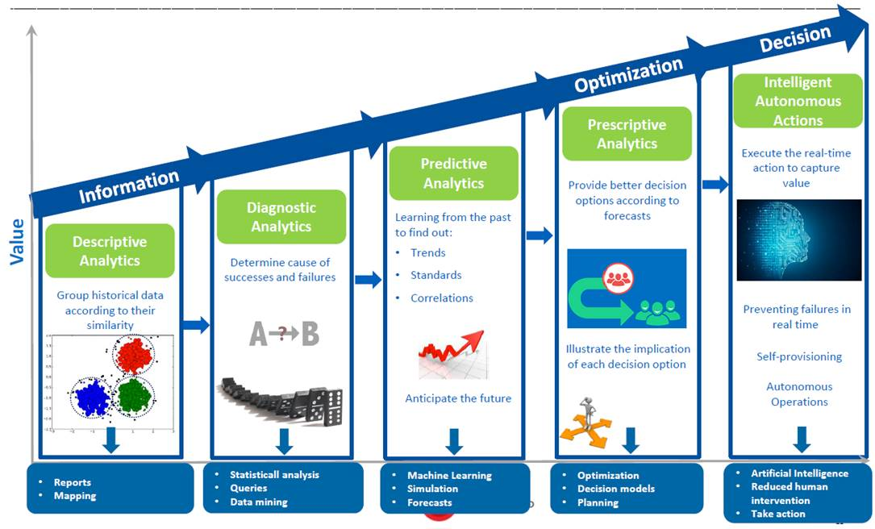
Maturity and ambition for data driven solutions
Asset information models
Data Insights
Data-driven Insights
What happened
Why it happened
What is likely to happen
How to prevent it from happening
Stay clear of unwanted events happening
Notes:
Descriptive Analytics (Visual Analytics) Know what is happening now by creating a context-relevant and interactive business view, showing historical trends and patterns through dashboards and BI reports.
Diagnostic Analytics Determine why something has happened, using content analytics and natural language processing
Predictive analytics Assess what could happen next, by using predictive models. Discover patterns and trends from all types of data.
Prescriptive Analytics (Decision Support) Recommends one or more courses of action based on predictive modeling, localized rules, scoring and optimization techniques
Cognitive Analytics / Intelligent Autonomous actions AI systems that learn from interaction and outcome in a naturally human-like way, allowing to find correlations, create hypotheses and learn from the outcomes.
Machine readable data is needed for any kind of automomous behaviour.
Digital requirements -> READII project
Sensor data
Digital requirements (e.g. standards) -> e.g. requirements for data quality or e.g. ISO standard
Based on ontology, have machine readable data & verify that we have the right data in place.
An asset model ontology, for automated verifications.

Slide 8
Data – the fuel that’s powering digitalization DNV research shows:
79% Agrees that a reliable decentralized energy system is impossible without digitalization
71% Has an increased focus on digitalization over the past year
72% Agrees that they need to embrace digitalization to increase profitability
72% Will prioritize improving data quality and availability in 2022
Source: Power of Optimism, Industry Insights, DNV 2022. Percentages reflect net agreement statements.
Notes:
Data is the fuel powering digitalization, which in turn enables the energy transition the industry so desperately need.
The energy industry do to a large extent agree that digitalization is crucial to managing the burgeoning complexity of the new energy system, where multiple inputs must be integrated and numerous processes need to be automated to ensure services are reliable and resilient.
According to our Industry Outlook report “The Power of Optimism, where over 1000 senior energy executives across power, renewables, oil and gas and industrial energy use sectors share their views on the energy transition, a total of 79 % agrees that a reliable decentralized energy system is impossible without digitalization.
Moreover, 71 % of respondents has increased focus on digitalization over the past year.
72 % also believes that their organization needs to embrace digitalization to increase profitability
These digitalization priorities reflect increasing importance of data driven strategies and automation, and not surprisingly, 72 % reports that improving data quality and availability is a key priority for the next year. As the industry is increasingly making decisions based on large data sets, it is critical that they have control of data quality.

Slide 9
Digitalization: Huge potential, but hard to get it right
“Digital leaders” who are succeeding with a digital transformation achieved roughly
6 % points more return on digital investments compared to non-leaders and reported stronger revenue growth¹
Only 16 % of respondents say their organizations’ digital transformation have successfully improved performance and also equipped them to sustain changes in the long term²
Notes:
Organizations that get their digital transformation efforts right are reaping significant rewards, but few get it right. Companies invest in digital for various reasons including increased efficiency and productivity by automating manual tasks, improving resource management through optimizing IT spending and opting for more flexible consumption models, increased resiliency and agility to be able to quickly adapt to rapid market changes, and improving customer experience making use of data to gain customer insight and optimize the customer journey and offerings. Research by EY found that “digital leaders” who are succeeding with digital achieved roughly six percentage points more return on digital investments compared to non-leaders and reported stronger revenue growth.
However, according to McKinsey research, only 16 % of respondents say their organizations’ digital transformation have successfully improved performance and also equipped them to sustain changes in the long term. And the odds are even worse in traditional industries like oil &gas and infrastructure where the success rate falls between 4 and 11 %.
How leading companies accelerate their digital strategy, EY, 2021: https://www.ey.com/en_gl/strategy/how-leading-companies-accelerate-their-digital-strategy
Unlocking success in digital transformations, McKinsey, 2018: https://www.mckinsey.com/business-functions/people-and-organizational-performance/our-insights/unlocking-success-in-digital-transformations

Slide 10
Getting value out of data: The Trust barrier The Digital Journey towards Data Insights and Data-driven Insights
Data made available
Data made usable
Data actually used for predictions & automation
Operational and trusted digital solution
placeholder
Trust Barrier
Getting the data
Data ingest / ETL
IoT Sensor data acquisition
Streaming analytics
API management
Cloud storage
User management
Secure access
Managing data
Data quality management
Data quality dashboards
Asset modelling
Contextualize data
Risk assessment
Data quality improvement
Become Data-driven
Data insights
KPI dashboards
Forecasting / trend analysis
Predictive Maintenance
Digital Twin, Analytics, AI/ML
Autonomy
Towards actual Business impact
Can I trust my data-driven solution?
QA, Testing and of Assurance of data driven models
Moving from pilots/prototypes to operational systems
Operational Deployment
Deployment & support
Maintenance & SLA
Evaluation of outcome and results
Upgrades
Continuous Assurance of Digital Asset solutions
Improved efficiency, lower costs, higher user experience

Slide 11
Digital Twin in Power & utilities
A Digital Twin is a digital representation of (parts of) the power grid. They allow to create a cohesive bond between the physical and digital world. A digital twin combines data from the physical model of the object with data retrieved from the actual object. Digital twins can be used for:
Asset visualization
Asset management/predictive maintenance
Performance optimization/event prediction
Combined with Machine Learning (ML), DT’s enable:
(near) real-time performance monitoring
scenario analysis
simulation of operational conditions
Digital Asset
Physical
Virtual
Work Processes
Actions
Decision support
Computation models
Data
Asset Information Model
A digital twin is a virtual representation of a system or asset, that calculates system states and makes system information available, through integrated models and data, with the purpose of providing decision support, over its lifecycle.
Notes:
A digital twin is a virtual representation of a system or asset, that calculates system states and makes system information available, through integrated models and data, with the purpose of providing decision support, over its lifecycle.
The Energy industry has used digital twins for a long time, be it under different names, for example grid modelling tools, SCADA systems, and power flow models. Upcoming capabilities related to sensoring, data storage and data analytics (AI/ML) will enable Digital Twins to play an ever increasing role in efficient decision support for saving cost and driving innovation.
Examples of key drivers include:
Operational efficiency
Remote operations
Supporting sustainability goals
The market for digital twins is likely to grow with a factor of 3 from 2021 to 2026.
Digital twins differ in scale and complexity. Different capability levels can be defined for the functional element of a digital twin mapped to the previously mentioned evolution of the functional element.
The higher capability, the more value. But as the complexity increases, so does the risk that the digital twin may not deliver what buyers expect and could leave operators wondering if they can trust information from a twin.
DNV recommends that the following four aspects should be considered when assessing trustworthiness of a digital twin:
The organizational maturity – an assessment of the organization’s capabilities to transform digitally, including people, tools, technology, processes and competence to develop and maintain qualified digital twins. The quality of the digital twin – assess that the digital twin meets the stated requirements and with the right quality.
Risk of use – assess the risk of using digital twins to support decisions.
Continuous assurance – ensure and assess that digital twins remain qualified over the lifetime of the asset

Slide 12
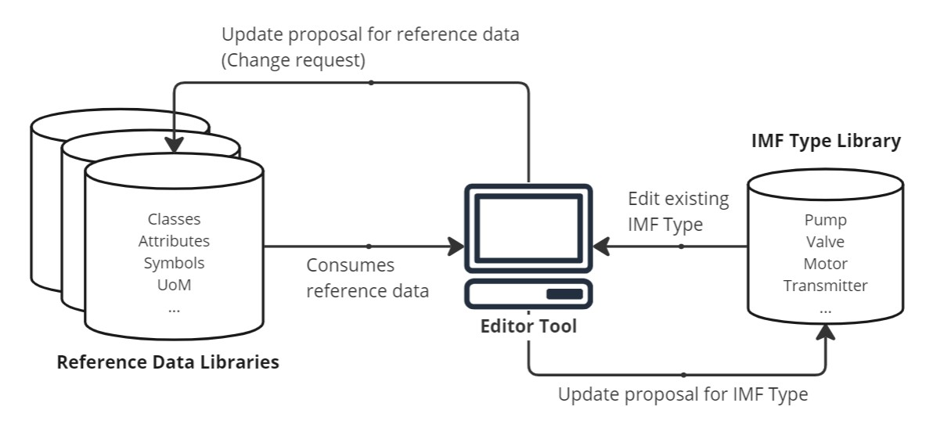
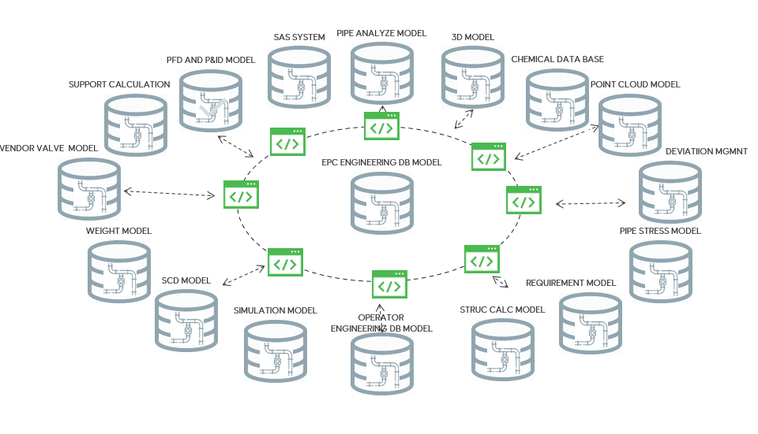
Digital Twin solutions covering the full asset life cycle
FEED
Design
Fabrication
Installation
Operation
Digital Twin during design
Asset information model (AIM)
Master data
Tags & classes
Graphical models
Computation models
Finance & Context
Documentation
Digital Twin in operation
Reference data libraries & IMF type libriaries
Need & Key decision
Std. asset breakdown structure
Data Validation Rules
Digital requirements
Dashboard & Quality indicator
…
Functional element domain
EqHub
Computation model(s)
PCA
Work processes
Joint Industry Project
Machine-interpretable vocabulary
Asset information model
Information Modelling framework
Definitions and principles
Data streams

Slide 13
Why do some Digital Twin solutions fail to deliver value?
Investments in digital twins are high but many fail to deliver business value (BCG and DNV studies)
Too technology oriented, not business case driven
Not integrated into the work processes → add on and not optimized
Black-box experience. → lack of trust and commitment
Keeping it up-to-date and relevant over time
Notes:
Boston Consulting Group published in 2020 a study which revealed that, although oil and gas companies are increasingly creating digital twins, many organizations are failing to capture the potential value. This is also in line with DNV experience working with our customers.
We see three main reasons the digital twin investments fail:
The solution is too technology oriented, focusing on what is possible with a computation model or existing data, rather than focusing on the value adding business cases
The digital twin solution is not properly integrated into the decision making and work processes. Often to solution some sort of dashboard with some information without considering if it fits into the decision making process. Also many digital twin solution lack proper support so the users are left to figure out any issues for them selves. Such solutions are an add-on rather than a solution that is relied on, which means that the solution adds cost rather than contributing to reducing costs.
The user experience the digital twin as a black-box where they do not understand how the computation models work or if the data quality of the input data is good. As a result the users do not trust the output and do not rely on the system. Instead they rely on their existing solutions or create their own.
After the DT / FE is implemented, then it fails to remain updated and relevant as the asset evolves and ultimately fails to deliver value. This often happens when the champion for it changes job or similar and no one takes responsibility for updating it.. Another reason is that datasets that the solution relies on are not updated and become outdated.

Slide 14
Building TRUST in the Digital Twin solution
Avoid building a “black box” where it is unclear how the output is created and if there are any conditions that causes it to be degraded.
The following prosperities must be in place to trust the Digital Twin solution (DT):
Sufficient data quality
Understand the algorithm and its limitations (in case of AI/ML: explainability)
Understand the uncertainty in the output
Quality Indicators to report data quality issues and DT faults
Confidence that the DT represent the asset over time
Processes to confirm that capabilities remains valid over time
Black Box
Notes:
Solutions that are behaving as a ‘black box’ cannot be trusted
AI-Act

Slide 15
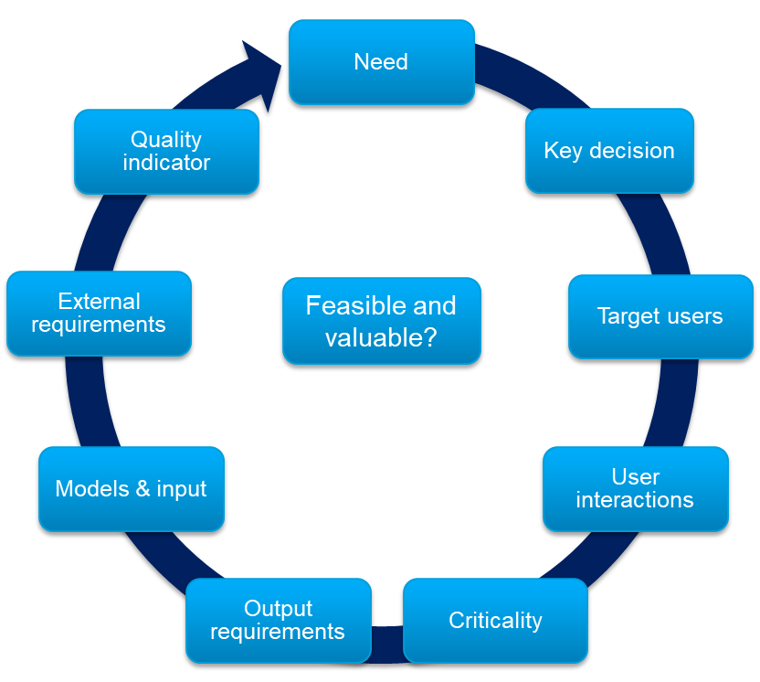
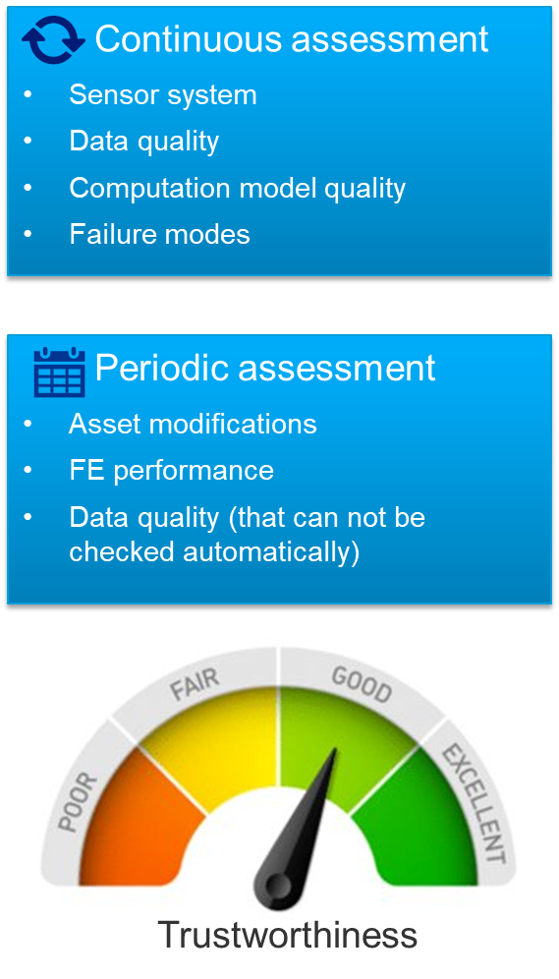
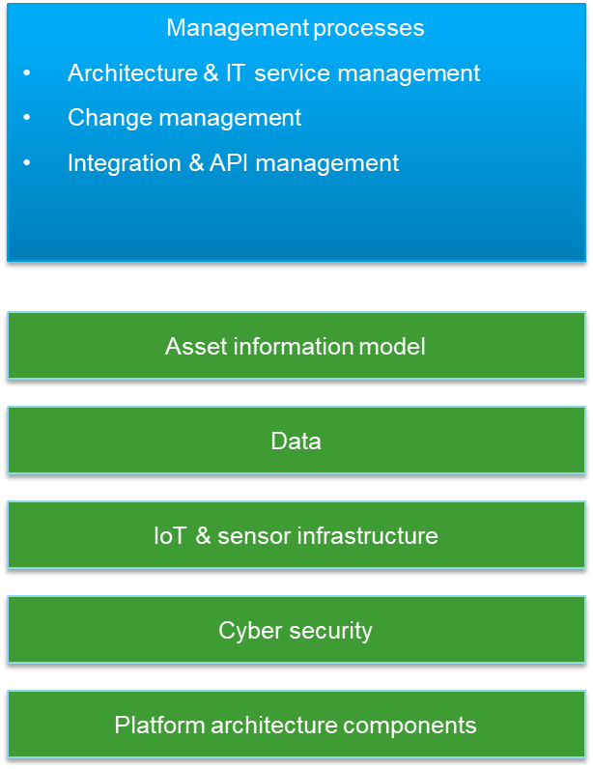
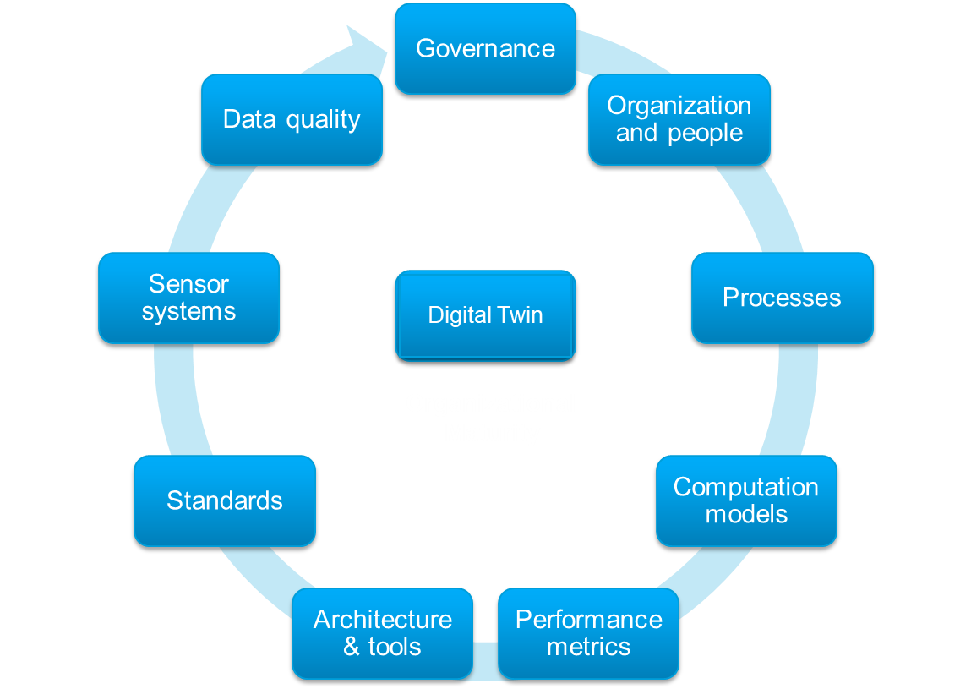
Four key questions related to Digital Twin maturity
1
Am I confident in specifying the scope of the digital twin’s functionality?
2
Will my digital twin work correctly and evolve alongside my physical asset over time?
3
Is my digital infrastructure right and safe for digital twin planning and operation??
4
Is my organization ready for digital twins and able to evolve alongside it?

Slide 16
DNV Recommended Practices for successful deployment across the data value chain
Design, building and Production/capture
Asset/storage
Calculation/processing/modelling
Analysis & decision making
Qualification and assurance of digital twins
DNV-RP-A204
Data quality DNV-RP-0497
Algorithm quality + (AI RP under development)
DNV-RP-0510
Sensor system quality
DNV-RP-0317
Cyber Security
DNV-RP-G108
Simulation models
DNV-RP-0513
Asset Information Models
New recommended practice Q1 2023 based on READI JIP
Efficient and trustworthy data sharing through clearly defined requirements and a robust assurance process to confirm that capabilities remain valid over time
Notes:
To help the industry overcome challenges and get value from digital investment, DNV has developed a series of recommended practices together with key industry players, including one on Data quality. These recommended practices take a holistic approach and are being used as frameworks for successful digital transformation across the data value chain from data production to analysis and decision-making. To be able to trust your data to make decisions, you are dependent on quality across the entire value chain. Ensuring quality is not a linear and single event, but a continuous process that requires a structured approach to governance.
Data management ensures that important data assets are formally managed throughout the enterprise and that data governance goals are achieved to realize efficiency gains and value creation. In addition to focus on data quality, data management also covers management of data storage, retention, life cycle, legal compliance and intellectual property rights, value chains, metadata, business vocabularies, information risks and information security.

Slide 17
The importance of understanding of what level your organisation is

Slide 18
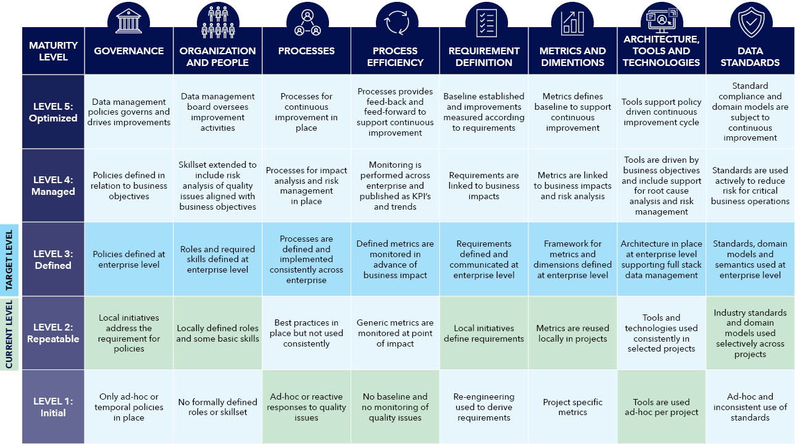
Example: Data Management Maturity Assessment
Notes:
Example of Maturity assessment according to RP 0497 Data Management

Slide 19
Digital Twin in Power & Utilities - examples and projects

Slide 20
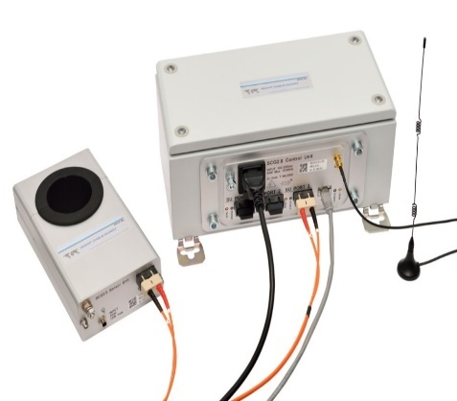
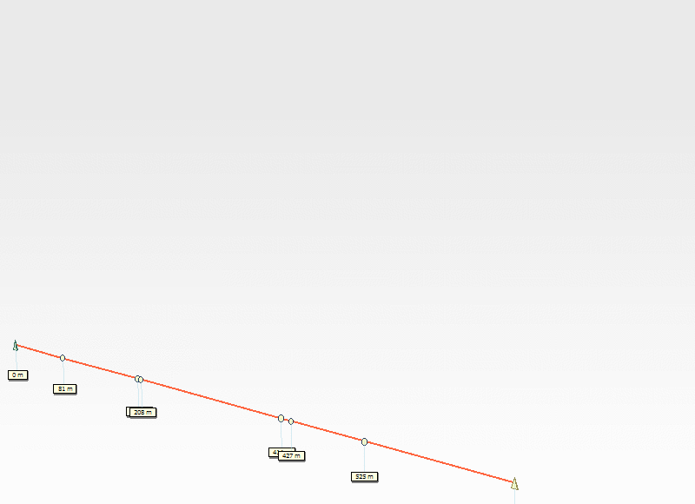
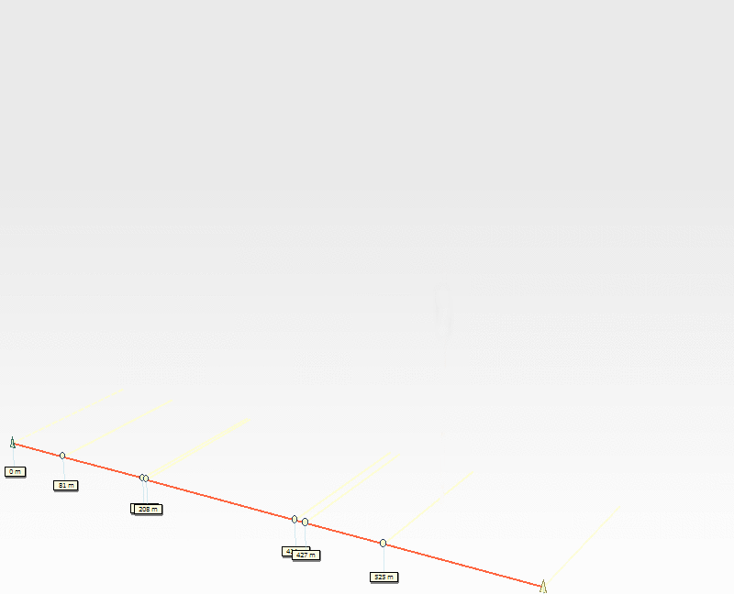
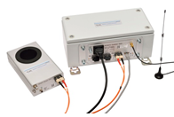
Example 1: Smart Cable Guard Digital Twin solution for cable failures
Partial Discharge in a 10 kV cable
PD trigger level, for example at 10 kV
Raw data
Warning level
Server
up to 16 km
defect
PD pulse
Synchronization pulse
20

Slide 21
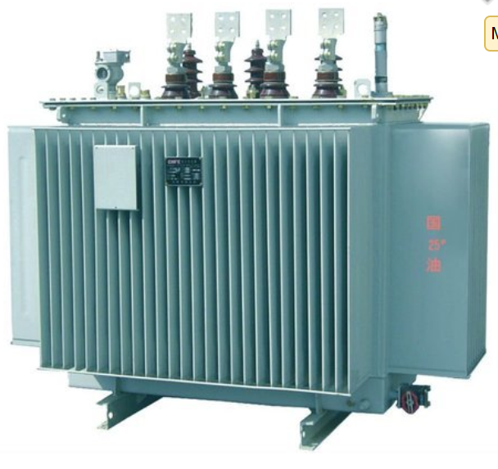
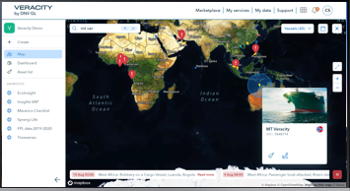
Example 2: Digital Twin for Power Transformers
Grid Analytics KPI Connect Digital Twin platform
Asset information (Transformers, Switchgear)
Asset KPI Dashboard Condition based analytics Predictive maintenance
Asset Management Decision
Sensor data
Metadata
Refurbish?
Context data
Replace?
3rd party data
Asset model
Real world impact

Slide 22
Assurance of Digital Asset Solutions

Slide 23
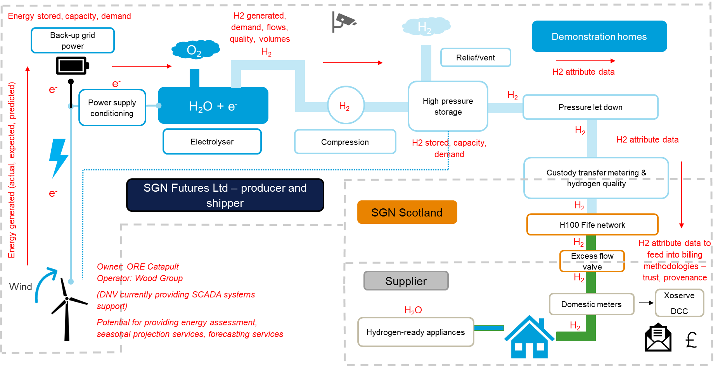
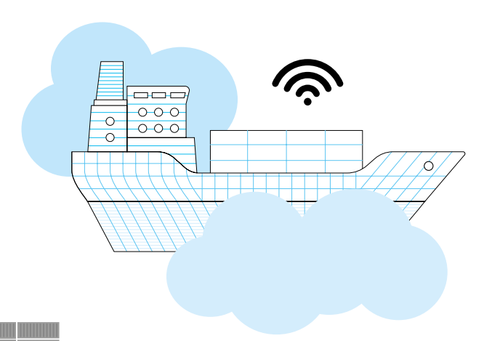
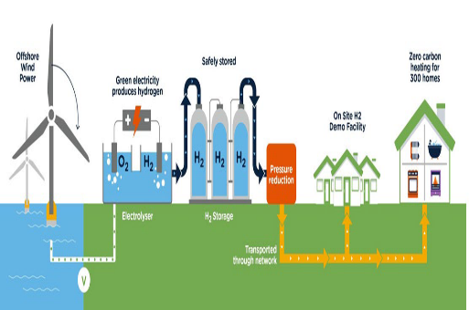
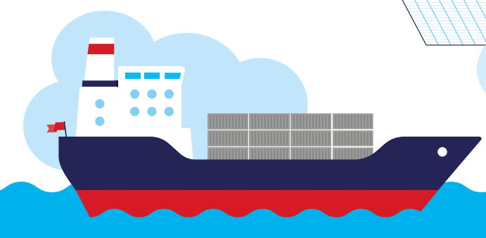
Project: Continuous Assurance of Digital Asset solutions - a process to confirm that Capabilities remain valid over time
Management of Changes
Functional Assurance
Operational Assurance
Virtual
Physical
Organisational Maturity
Organisational Maturity
Digital Twin Platform Assurance
Continuous & Periodic Assessments
Automated statements based on SaaS and Audits
Notes:
The innovation proposal and the fit with the strategic objectives:
Contribution to ES strategic themes:
Wind, Hydrogen, Sustainability, meeting Energy Demand and assurance of AI in Digital Twin Solutions - CONTINOUSLY
Overview and problem statement: Uncertainty in how the gas network will manage the future system’s foreseen complexity, sustained focus on the safety, resilience, energy demand and sustainability of the future network whilst ensuring assets and infrastructure are compatible with green hydrogen gas blend (using wind turbines)
Digital transformation strategies, developing roadmaps based on use-cases, Qualification and Assurance of Digital Twin solutions (DNV-RP-A204) and develop continuous assurance toolbox and tech stack using Veracity
Input, pilots and verifications of Service and Business models and framworks for Digital asset solutions
Business Impact (e.g. revenue / market share) & Customer insights
What is the customer benefit and our value proposition?
to explore the commercial, societal and operational benefits that could be derived from the deployment of unified digital twin solutions on the energy network, both current and future by:
aiming to design this proposed ecosystem of connected digital twin solutions with flexibility and extendibility at its heart
demonstrate the concept of connected digital twin solutions is hugely beneficial and fulfil the digital strategy and vision
aligned to the strategic vision of Ofgem and the networks;
completely aligned with the Gemini principles shared by the National Digital Twin programme;
using DNV-RP-A204 (qualification and assurance of digital twins) to verify the digital twin solutions over its lifecycle (design, engineering, operation and e-commissioning)
ultimately, we expect our project outcomes to save money and reduce cost -- for example:
by verifying the design and engineering
by managing provision of electricity to the grid;
to produce hydrogen, depending on price or capacity;
Peaking plant management and energy storage
to predict critical maintenance;
to automate the process of utilising more green hydrogen into the asset
What are potential customers / customer segment / market segments / geography for this innovation service?
Project partners (SGN (lead), NG ESO, NG GT&M, DNV, IBM, AWS, ESRI)
Market segment: Gas distribution
The potential to materialize new business models (capacity decoupled revenue streams)
Support the energy industry objectives to build knowledge and competence in data, modernise energy data access and stimulate innovation across the industry through digital twin solutions.
Support connectivity to renewables, new technologies and different players, stakeholders and regulators
Digital Twin (A204): Virtual representation of a system or asset that calculates system states and makes system information available, through integrated models and data, with the purpose of providing decision support over its lifecycle
Connected digital twin solutions will aid the development of the future energy production and storage capabilities.
Role of digitalization
Cross sector collaboration and connectivity:
Gas System of the Future (GSOTF) Specific funding is external (strategic innovation fund), but linked to TSA funding through the DNV DT Venture who are supporting:
Qualification and Assurance of Digital Twin solutions and Connected Digital Twins
Continuous Assurance of Digital Twin solutions (CADT)
GSOTF allows interaction between project team and DT Venture, including support both ways.
ES; Offshore Technology designed the 7MW Turbine
Renewables; Renewable Energy Analytics manage the SCADA System
RA; Offshore and Methodology are writing the Case For Safety and Bridging Documents
R&T; Repair and Intervention are leading the design assurance of Arup’s designs.
DS; Performance Solutions are continuously supporting and providing insight on gas network operations
ES/DS; development of continuous assurance toolbox and tech stack
DEPENDING ON DEVELOPING CONTINUOUS ASSURANCE AS-A-SERVICE THAT IS BASED ON A PROCESS THAT IN AN AUTOMATED FASHION ENSURES THAT CLAIMS AND REQUIREMENTS REMAIN VALID OVER TIME (REF INOVATION IDEAS 2023…)

Slide 24
Project: Digitalization and collaboration to establish Information Model Definitions & Data Validation Architecture
2
1
3
EPCs & suppliers uses Reference data libraries & IMF type libraries to model their design.
Utilize common Reference data and Definitions on standardized machinreadable formats
Operators uses Reference data libraries & IMF type libraries to model the requirements based on digital BoD and SoR.
EPC’s, Vendors & Suppliers
Services
Services
License-owners & Operators
Automated verifications
Data quality
Digital MoC
Service X
Automated verifications
Data quality
Digital MoC
Service X
Project Execution Control
Vendor Data Mngt.
Data Quality & Approval
App X
Reference data libraries & IMF type libriaries
Data Quality & Approval
Review & Collaborate
LCI requirement
App X
…
Std. asset breakdown structure
Data Validation Rules
Digital requirements
EqHub
Vendors
EPC Platform – Digital Twin
PCA
Operator Data Platform – Digital Twin solutions
Machine-interpretable vocabulary
Information Modelling framework
Definitions and principles
DFO
e.g ICCS
Life of field services
Projects
Power & utilities
Offshore wind
Greenfields
Brownfields
Staged Asset
Versioned
Data Model
Data Validation
Customer API
Staged Asset
Versioned
Data Model
Data Validation
EPC API
Power &
Utilities
Suppliers
Updated Design Data based on RDL (machine readable)
Versioned
Information Model Compliant
Data Validation Certificate
Rich customer API covering populated information model for re-creating the digital asset in customers data platform
Digital commissioning
Offshore
wind
Asset 3
3D - Engineering Design - Simulators
OPS – ERP – OT - D&W - Petec
Eng. Eq.
4
EPC notifies Owner/Operator when a new asset data version
meeting contracted requirements is available
6
EPC share Asset data in client project according to requirements and prepares managed versions with agreed quality.
5
Owner/Operator receives version of
asset data in staging environment to perform validation and sign-off the delivery before populating their system landscape and integrating with OPS/OT data universe.
7
Review, Collaborate, approve asset model solution
8
Condition-Data enabling Life of Field Services
Notes:
Key Stakeholder:

Slide 25
How can DNV help
Thank you for your attention
Key DNV Digital Transformation services
Self Assessments
Statement of Capabilities
Advisory Services
Continuous & Periodic assessments
Independent Assessments
Statement of Compliance
Qualification and Assurance of Digital Twins DNV-RP-A204
Maturity assessments
Data quality
DNV-RP-0497
Algorithm quality
DNV-RP-0510
Sensor system quality
DNV-RP- 0317
Simulation models
DNV-RP-0513
Cyber Security
DNV-RP-G108
Asset information Models
READI JIP (RP under development)
Strategy roadmaps
Gap analysis & change management
Data quality indicators & monitoring
Functional Element assurance
Continuous Assurance
Theo.borst@dnv.com
ove.heitmann.hansen@dnv.com
+31646713715
+4791787024
www.dnv.com
Notes:
Our services, processes and Recommended Practices
THANK YOU!
Questions…. ??

